Slide 1
R and APIs: new ways of working in local public health intelligence
Andy Evans
Birmingham City Council Public Health – Knowledge, Evidence & Governance Team
November 2019

Slide 2
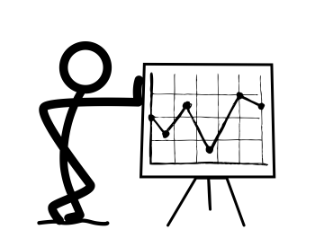









Traditional methods of data analysis
Share Output
Request
data
Clean, process & analyse data
SECURE
ZONE

Slide 3
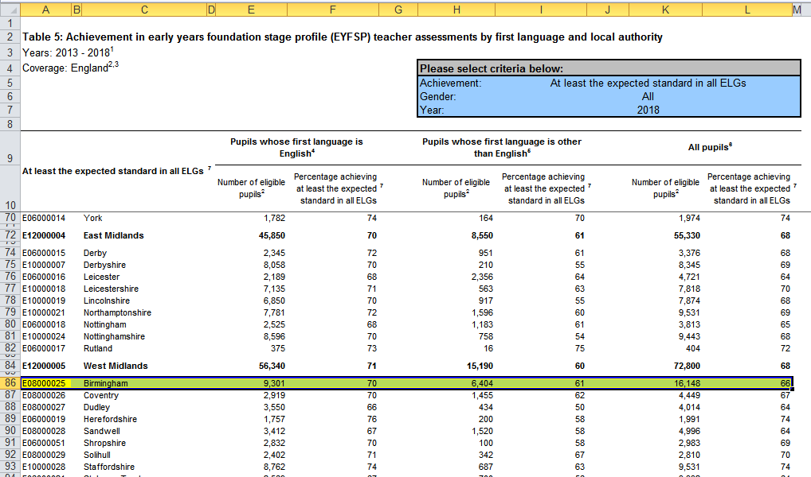

Why change?

Slide 4
Why change?
Time consuming / labour intensive
Automate to reduce repeated tasks
High potential for human error
No audit trail
Limited scope for interactive output

Slide 5


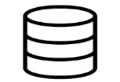








New methods of automation and data science
Automated data collection through API
SECURE
ZONE
SQL Server
Aggregated / non-sensitive data only
Dynamic reports shared via intranet / web. Suitable for viewing on multiple device types
SSIS automated data transfer
Data processing / analysis / visualisation using latest technologies. Maximised automation
Cloud Storage

Slide 6

What are APIs
Application Programming Interface
Used to communicate programmatically between systems
API is like a waiter at a restaurant. You make an order and the chef cooks it. You don’t need to know the recipe.
For analysts its an easy way to programmatically search and extract data over the internet using web APIs

Slide 7

How do APIs Help
Extract data programmatically – no repeated manual steps
Get just the data you require
The data is usually up to date
https://www.nomisweb.co.uk/api/v01/dataset/NM_2002_1.data.csv?geography=1816133698&date=latest&gender=0&c_age=200&measures=20100

Slide 8

What did I need to learn / understand
What an API was
How to make an API call
A little bit about JSON data
Better understanding of lists in R
Understanding of the how each API works

Slide 9
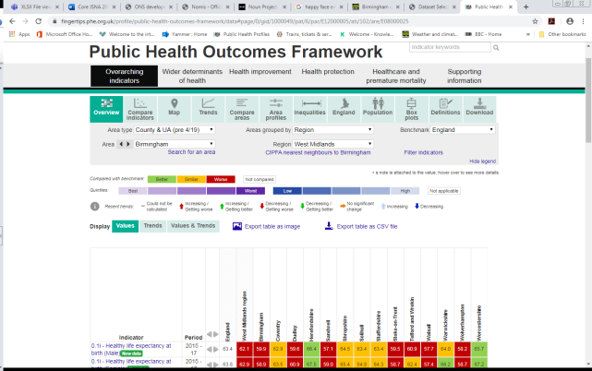
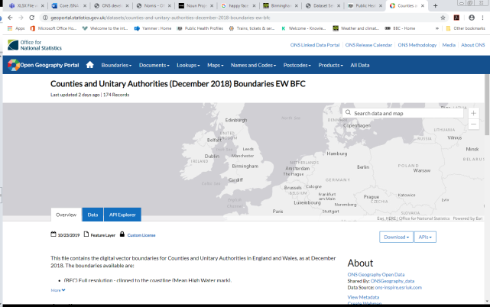
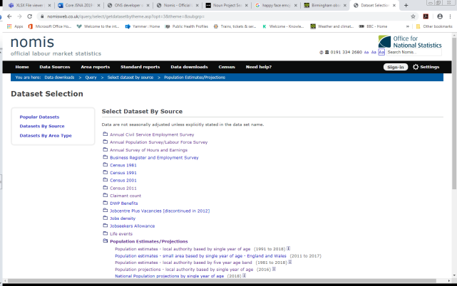
Which APIs to use
Started with Fingertips – made easier with fingertipsR package
NOMIS and nomisr package
Open Geography
Portal
ONS
NHS Digital (ODS)

Slide 10
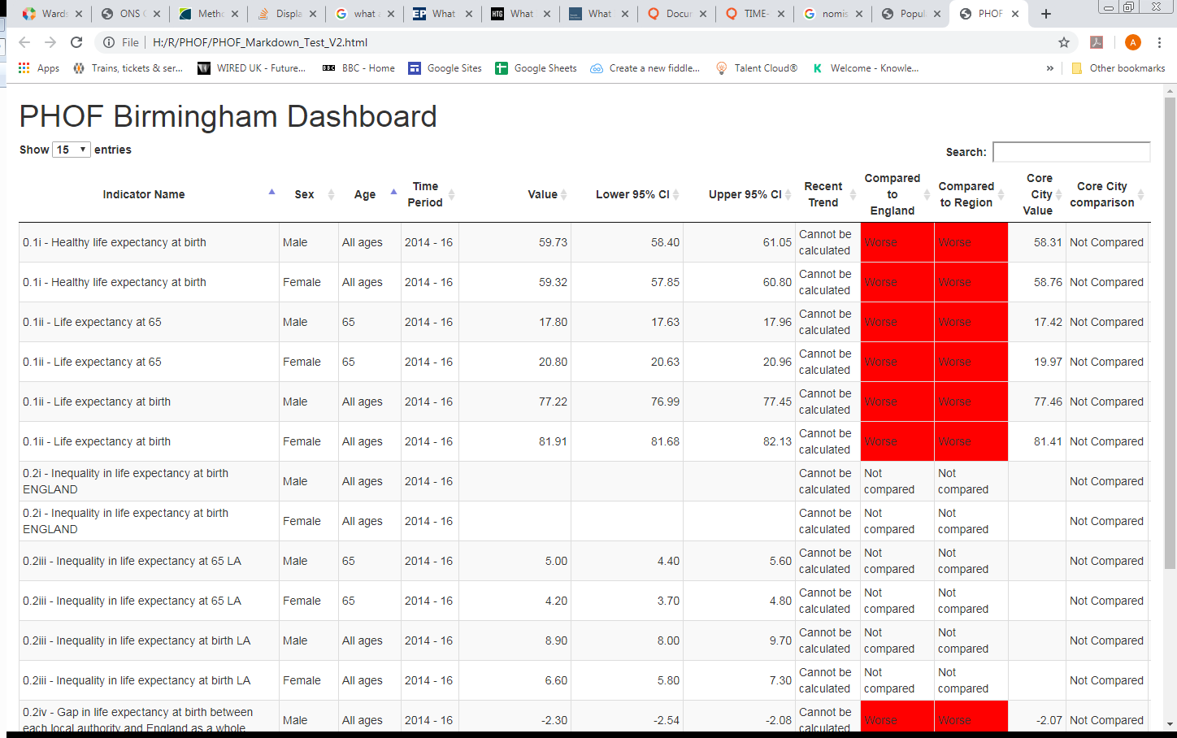
Examples of work – fingertipsR

Slide 11
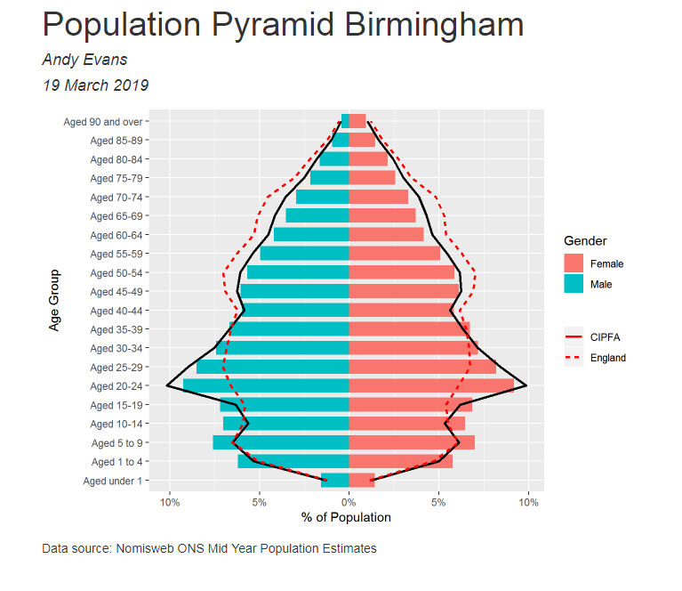
Examples of work – Nomis API

Slide 12
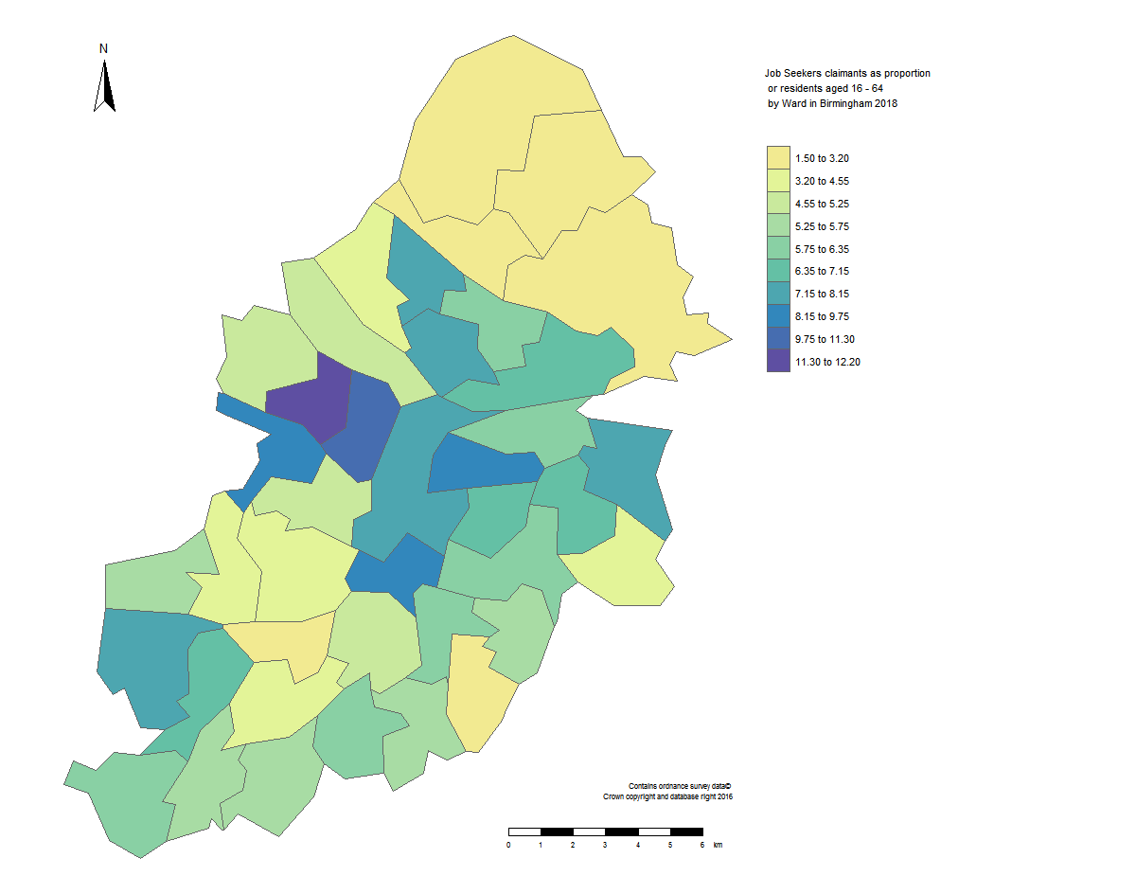
Examples of work – Combine data with spatial data from Open Geography Portal

Slide 13
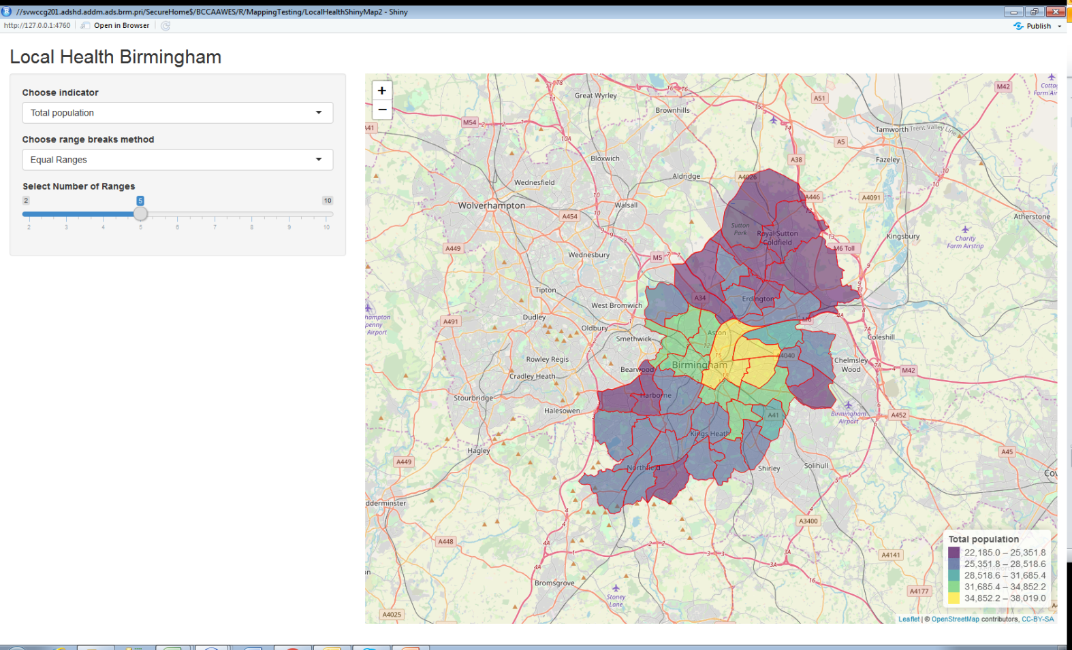
Examples of work – Interactive output using Shiny and Leaflet

Slide 14

Still have plenty to learn
How to do more advanced queries when making API calls
How to flatten nested JSON data – HELP PLEASE!!!!
Better understanding of nomis API and others
More intelligent ways of working with API data
Possibly sharing our data with an API

Slide 15
andrew.j.evans@birmingham.gov.uk

